Slide 1

Your past, your present and your future

Slide 2


Slide 3
IDEA
What is Capsulefy?

Slide 4





Time capsule

Slide 5


Payment plans
 | Free | Premium
Price | 0 € | 11.99 €
Storage | 20 MB/user | 500 MB/capsule
Social network and email integration
Capsule scheduling | 1 year | No limit
Capsule expiration | 6 months after release | No expiration
Modular and private capsules

Slide 6
TECHNOLOGIES
What stack do we use?

Slide 7




Web app
Users and capsules
Media storage
Social network

Slide 8
COMPETITORS
What makes us different?

Slide 9
 | Viajeros en el tiempo | Mytimecapsule | Miigen | thetimecapsule | Capsulefy
Automatic content publication
Free plan
Premium plan
Images
Videos
Social network integration
Deadman switch

Slide 10
TEAM
Who is behind?

Slide 11
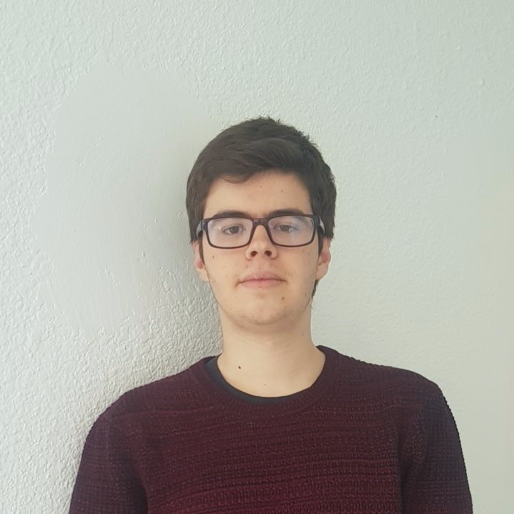
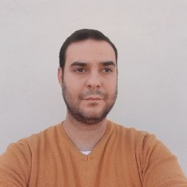




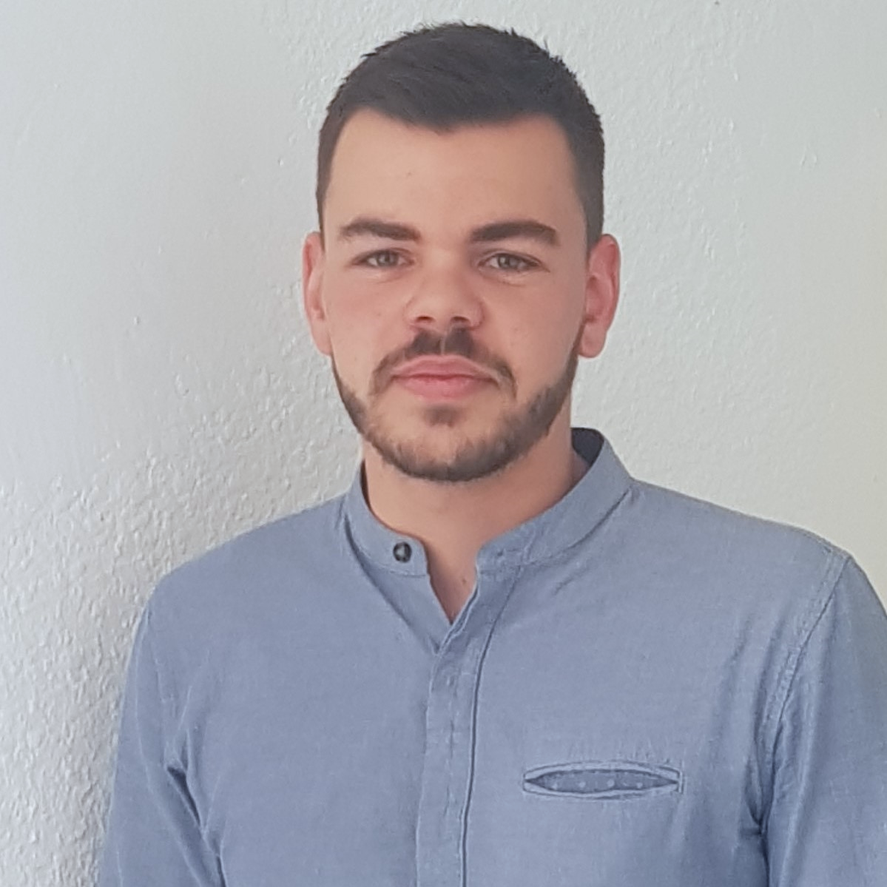
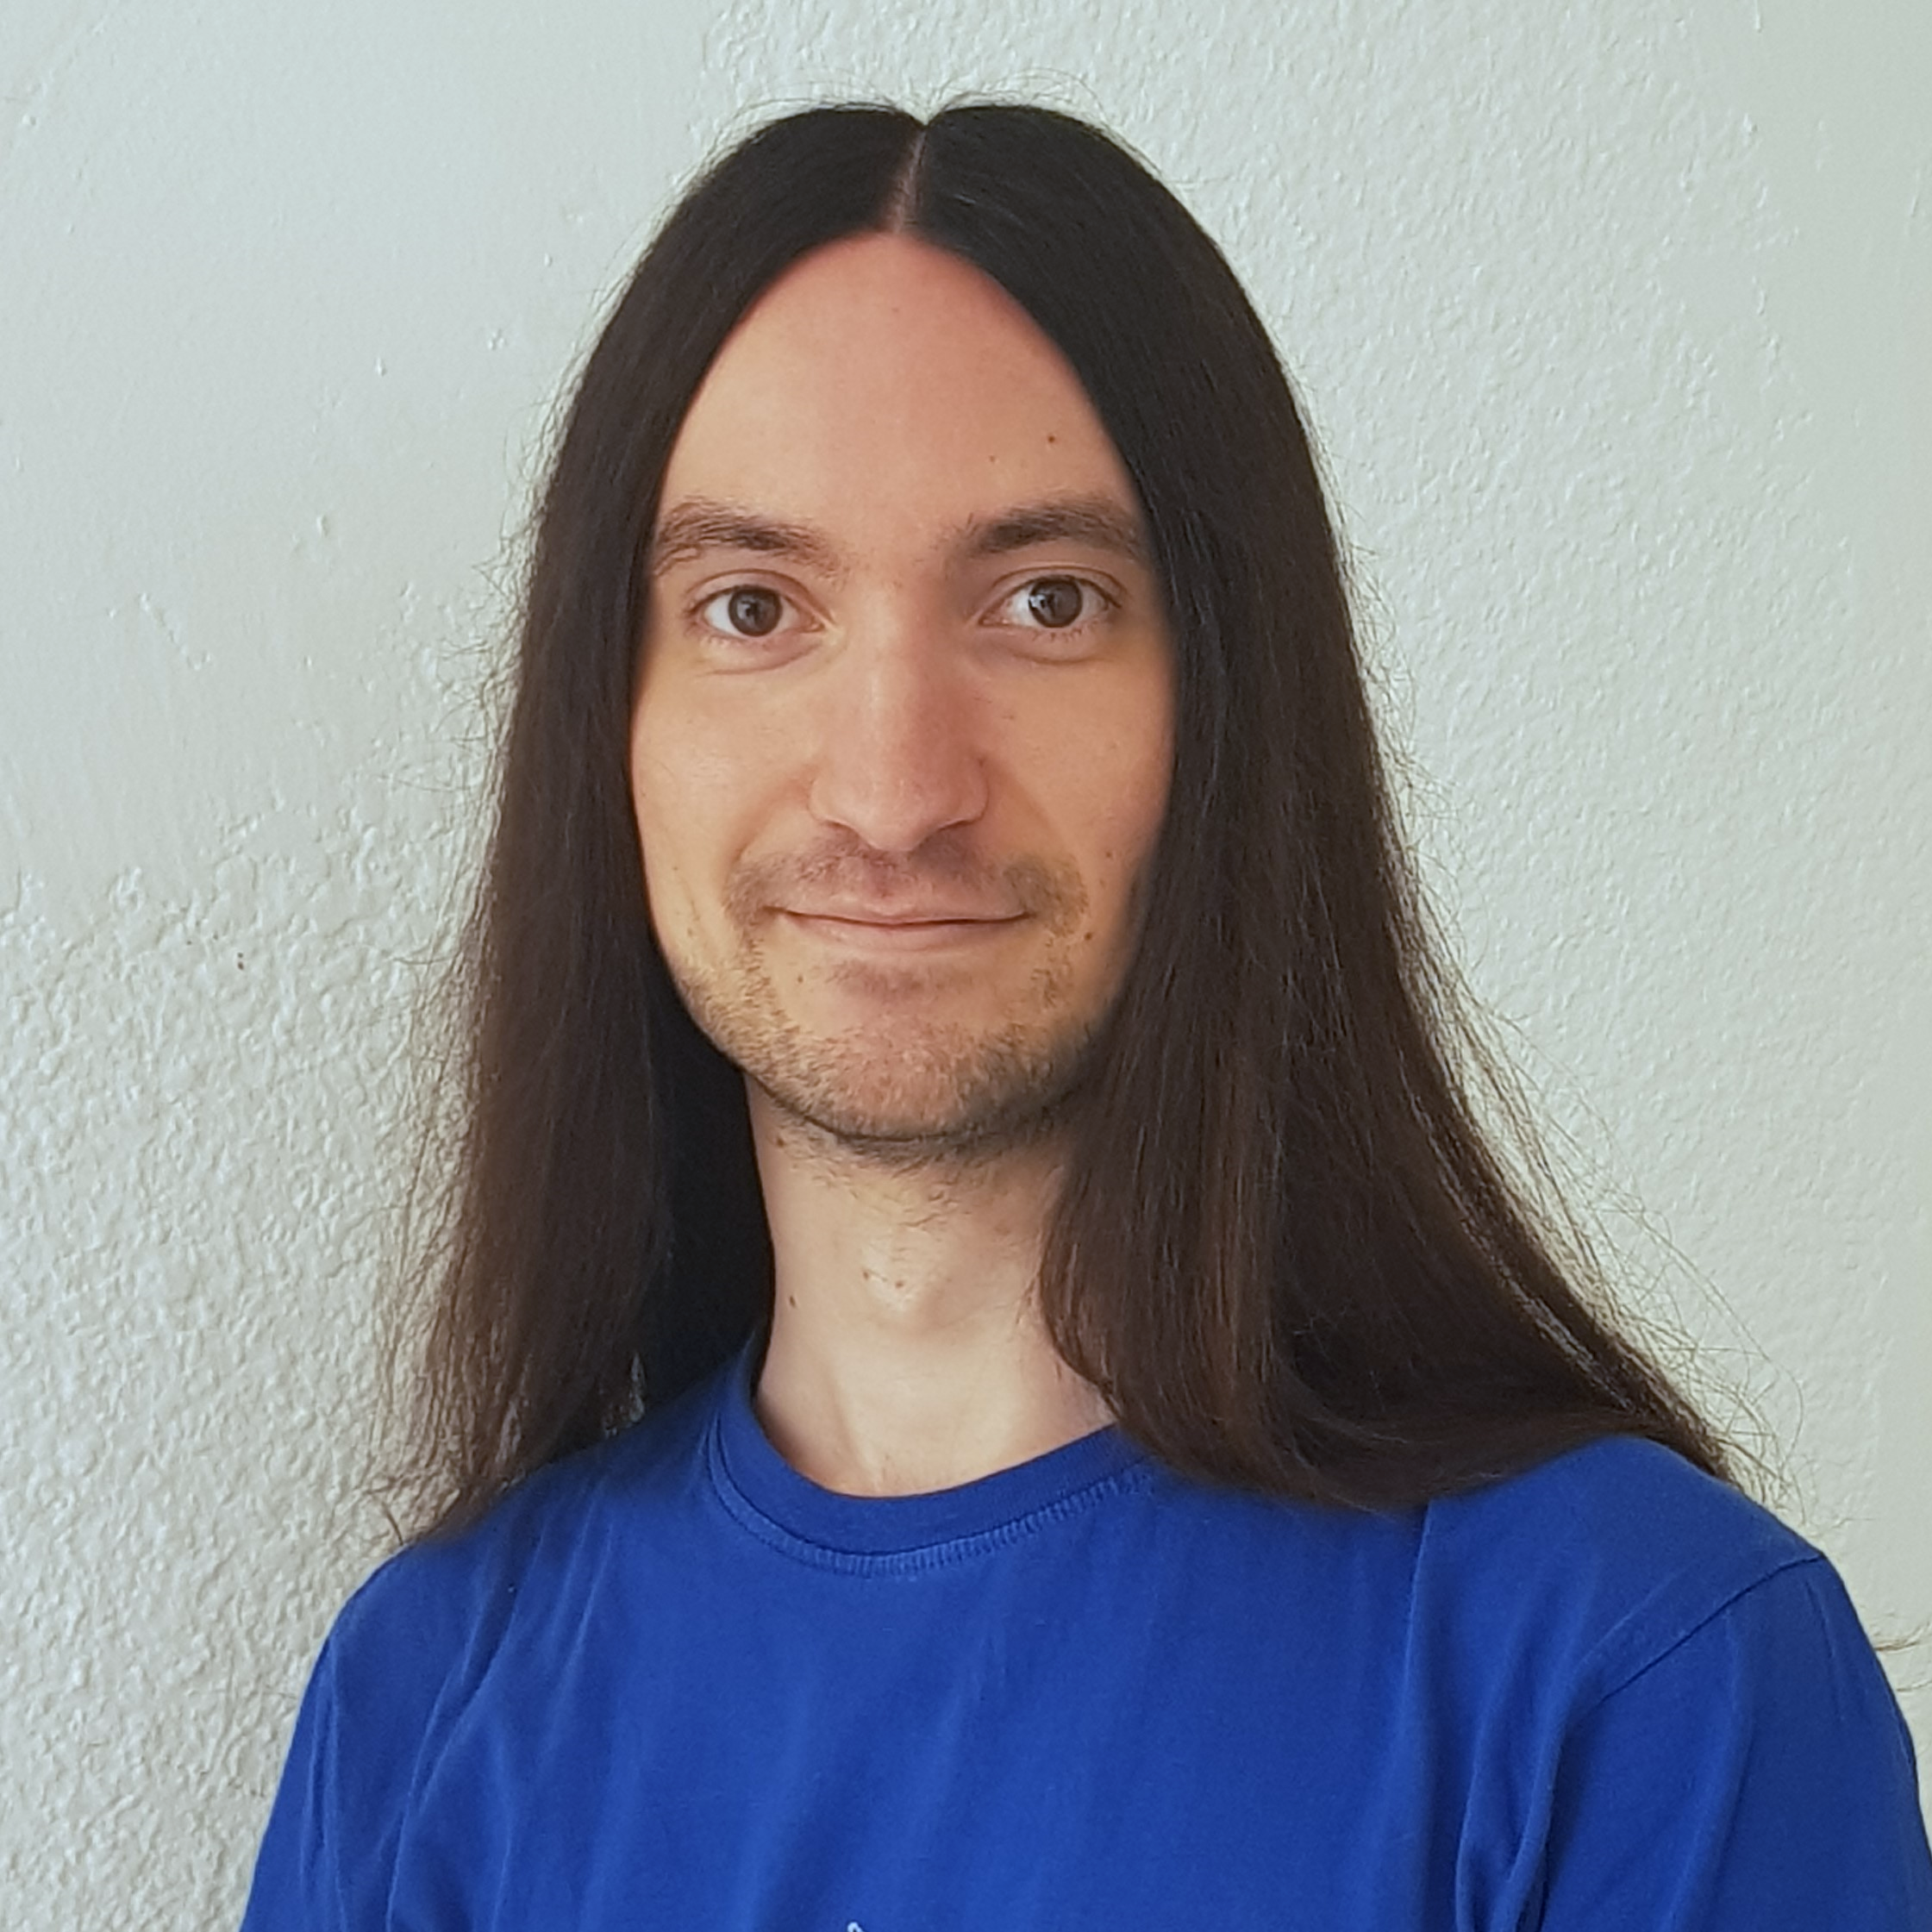


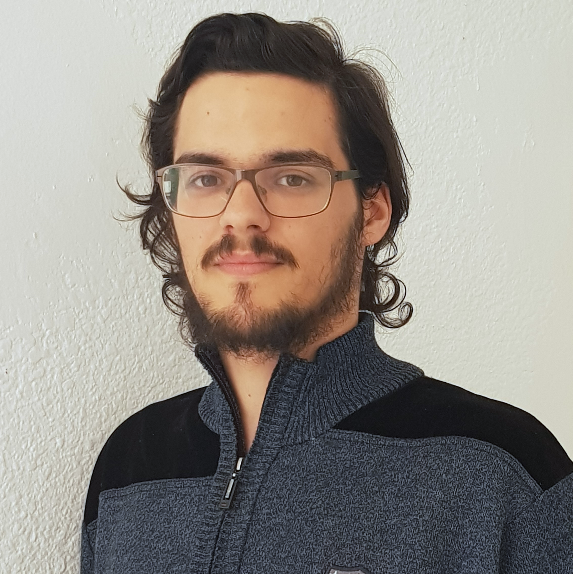



Pablo Rebollo
Project manager, backend developer
Juan Rodríguez
Requirements engineer, backend developer
Adrián Cantón
Business manager, full-stack developer
Rafael Fresno
Backend developer, API integration
Daniel Carpio
Analist,
frontend developer

Slide 12
COSTS
How much does Capsulefy cost?

Slide 13
Project duration | 4 months
Salaries | 20.80 €/hour
Hours per month | 40
Amortization | 60 months
Equipment | 306 €
Hosting (1 year) | 669 €
Advertising (6 months) | 3060 €
Customer support (1 year) | 15000 €
Risk prevention | 10% (2724 €)
Total | 44968 €

Slide 14



GDPR and measure calculation costs are included in the corresponding members’ salaries

Slide 15
DEMO
How does the system look like?

Slide 16
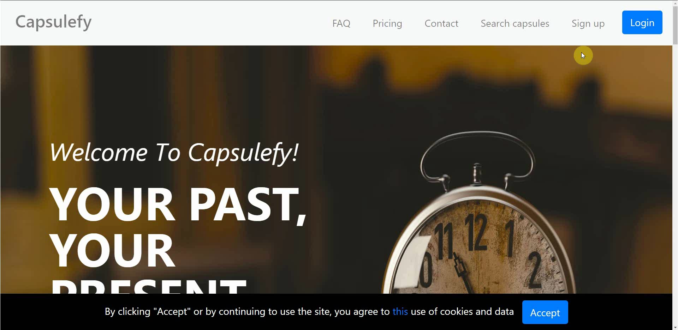
No logged user – Sign up

Slide 17
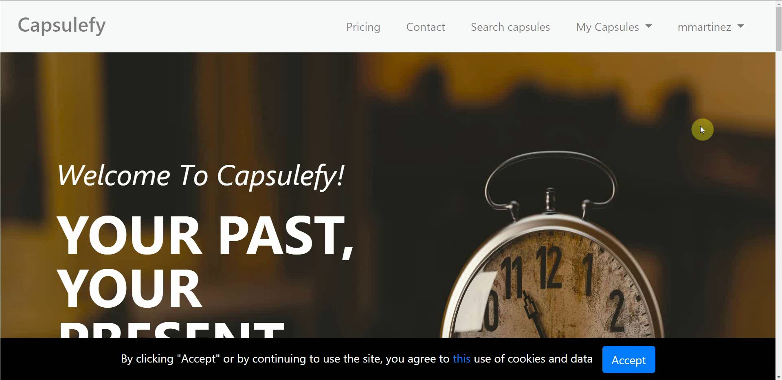
Logged-in user – Change password

Slide 18
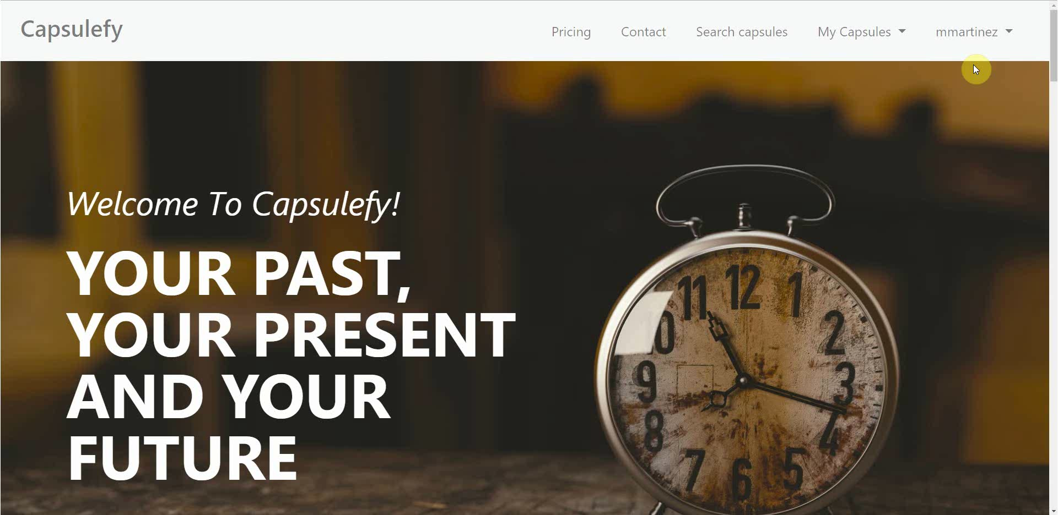
Logged-in user – Connect to Twitter

Slide 19
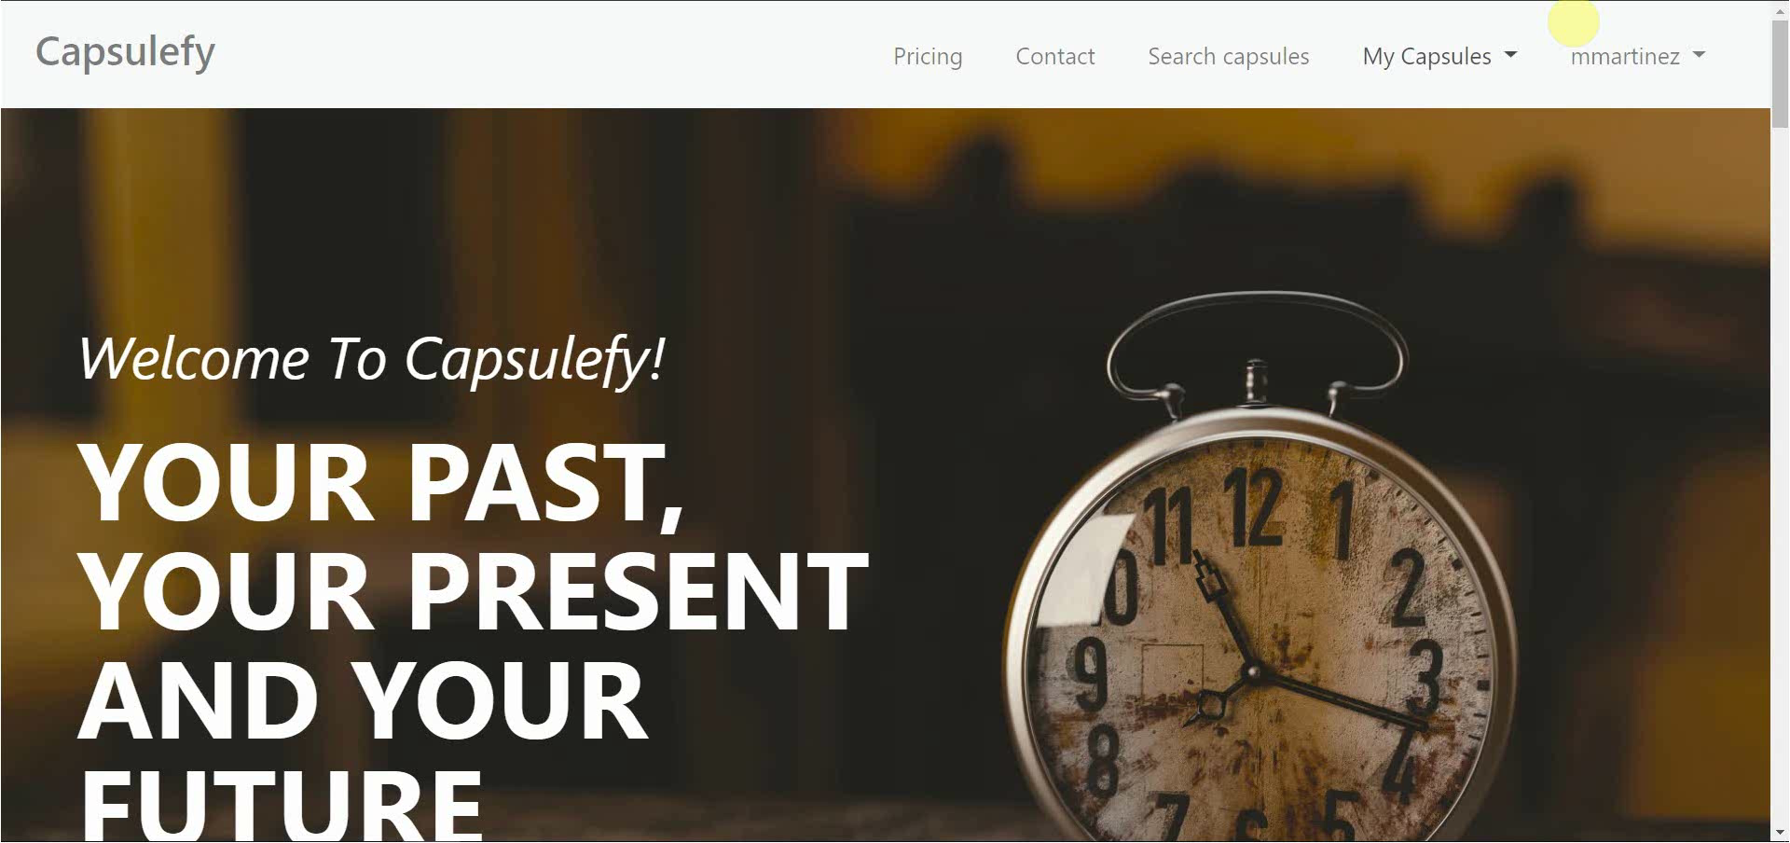
Logged-in user – Create and display capsule

Slide 20
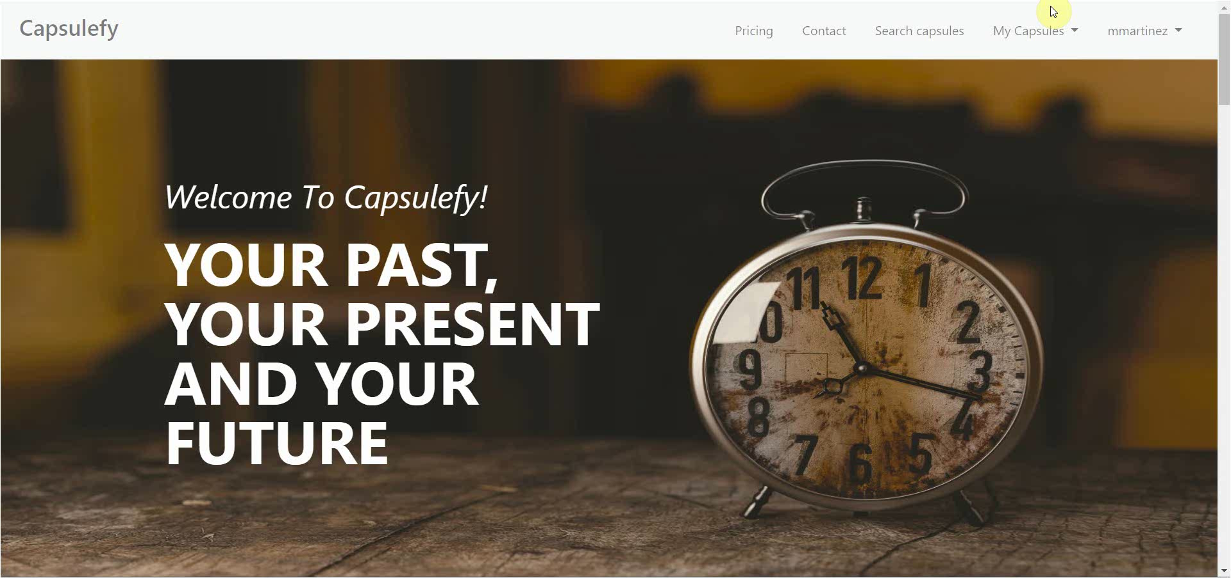
Logged-in user – Refresh timer

Slide 21

Logged-in user – Delete account

Slide 22
Thanks!
Upstream: https://capsulefy.herokuapp.com
Landing page: https://capsulefy01.herokuapp.com
Contact email: capsulefy.communications@gmail.com
GitHub releases: https://github.com/pabreblob/capsulefy/releases

Slide 23
GDPR
How do we comply with GDPR?

Slide 24

Users may delete their profile or capsules

Slide 25


Users can send an email to request unauthorized data deletion

Slide 26

Users will be prompted to reset their password if suspicious activity is detected

Slide 27


Users can send an email to retrieve all their stored data

Slide 28

All this information, including cookie usage, is available on our website

Slide 29


Users must agree to our terms of service before registering

Slide 30


What do we store?
Users:
- Full name
- Email
- Birthdate
- Notification email
- Social network token
Capsules:
- Content
- Files
- Emails
- Payment ID

Slide 31
PLANIFICATION
How do we organize development?

Slide 32
First sprint March 18th – March 29th | Core use cases Piloting plan
Second sprint April 1st – April 12th | Full MVP Feedback taken into account
Third sprint April 22nd – May 3rd | Polished MVP

Slide 33




Performance indicator
$$avg(\frac{Estimated time}{Invested time})$$
0.5
0.8
1.2
1.5
!
~
?

Slide 34
PM performance indicator
$$PMP∗avg\left(MP\right)−TD∗0.1$$
PMP: Project Manager performance
MP: Members performance
TD: Total task delays or
anticipations(days)
0.5
1.5
!
~
?

Slide 35

Relative performance indicator
$$\frac{avg(This week performance)}{avg(Last week performance)}$$
0.5
0.8
1.2
1.5
!
~
?

Slide 36



Factors affecting performance
Optimistic estimation
Wasted time
Difficulties
Pesimistic estimation
Easier tasks
Unknown technology

Slide 37



General solutions
Talk
Reschedule
Balance
Monitor

Slide 38
SPRINT 3 WEEK 1
April 22nd – April 28th

Slide 39
 |  | April
Task | Assignees | 22 | 23 | 24 | 25 | 26 | 27 | 28
Initial meeting | All
Improve checkboxes | Daniel
Coverage tests | Rafael
Unit tests | Adrián
Improve responsive | Daniel
Improve demo videos | Adrián
Add date picker | Juan
Fix sign up message | Juan

Slide 40
 |  | April
Task | Assignees | 22 | 23 | 24 | 25 | 26 | 27 | 28
Update costs | Pablo
GDPR | Pablo
Improve return button | Daniel
Improve 404 pages | Daniel
Improve email inputs | Daniel
Landing page content | Juan
Fix image proportions | Daniel
Test automation results | Pablo

Slide 41
 |  | April
Task | Assignees | 22 | 23 | 24 | 25 | 26 | 27 | 28
Improve dashboard | Juan
Review populate | Pablo
Presentation | Rafael
Advertisement video | Pablo
Rehearsal | Pablo

Slide 42
Performance
Pablo (PM) | 1.09
Daniel | 0.88
Rafael | 0.93
Adrián | 0.83
Juan | 1.1

Slide 43
Relative performance
This week | 0.96
Last week | 1.28
Result | 0.75

Slide 44
Project duration | 10 weeks (5 development)
Total salaries | 9797 €
Amortization | 60 months
Equipment | 265 €
Hosting and advertising | 0 €
Customer support | 15000 €
Risk prevention | 2724 €
Total | 27786 €
Project completion | 66 %
Spent budget | 61 %

Slide 45


What went wrong?
- What happened?
Two tasks had some delays.
- Solution
The PM will pay more
attention to task progress.
Task delays

Slide 46

What went wrong?
- Measure
Greatest delay in week 2 (days)
!
Task delays
2
3

Slide 47



What went wrong?
- What happened?
Creating a Facebook dev
account was not easy.
- Solution
Assign more people.
Facebook integration

Slide 48
What went wrong?
- Measure
Task completion in week 2 (%)
!
Facebook integration
50
75

Slide 49

Measures
Performance ratio
!
~
?
0.5
0.8
1.2
1.5
Divide tasks
W1 lowest performance: 0.83

Slide 50
Measures
Delay (days)
!
2
3
Divide tasks
W1 greatest delay: 1

Slide 51

Measures
Invested hours
!
6
7
Divide tasks
W1 task with most hours: 6

Slide 52

Measures
Invested days
!
6
7
Divide tasks
W1 task with most days: 4

Slide 53


Measures
Wiki entries
!
3
4
Better
tool usage
Wiki entries after W1: 6

Slide 54
SPRINT 3 WEEK 2
April 29th – May 3rd

Slide 55
 |  | April |  | May
Task | Assignees | 29 | 30 | 1 | 2 | 3
Feedback meeting | All
Update GDPR | Pablo
Facebook integration | Rafael
Fix nav header | Daniel
Capsule creation date | Daniel
Accept terms button | Juan
Name inconsistencies | Daniel
Remove unneeded links | Daniel

Slide 56
 |  | April |  | May
Task | Assignees | 29 | 30 | 1 | 2 | 3
Add favicon | Daniel
Password restriction | Juan
Password reset | Juan
Change email content | Juan
Add subtitles to ad | Pablo
Review populate | Pablo
Deploy app | Adrián
Record demo videos | Adrián

Slide 57
 |  | April |  | May
Task | Assignees | 29 | 30 | 1 | 2 | 3 | … | 12
Test app | Daniel, Juan
Presentation | Rafael
Sprint 3 doc | Pablo
StartUS tasks | Adrián
Rehearsal | Pablo

Slide 58
Performance
Pablo (PM) | 0.87
Daniel | 1.09
Rafael | 0.87
Adrián | 1
Juan | 0.99

Slide 59
Relative performance
This week | 0.96
Last week | 0.96
Result | 1

Slide 60
Project duration | 11 weeks (6 development)
Total salaries | 10484 €
Amortization | 60 months
Equipment | 292 €
Hosting and advertising | 0 €
Customer support | 15000 €
Risk prevention | 2724 €
Total | 28500 €
Project completion | 73 %
Spent budget | 63 %

Slide 61
Week 1 problems
- Measure
Greatest delay in week 2 (days)
!
Task delays
2
3
W2 greatest delay: 0

Slide 62
Week 1 problems
- Measure
Task completion in week 2 (%)
!
Facebook integration
50
75
Completion after W2: 40 %

Slide 63
Measures
Performance ratio
!
~
?
0.5
0.8
1.2
1.5
Divide tasks
W2 lowest performance: 0.87

Slide 64
Measures
Delay (days)
!
2
3
Divide tasks
W2 greatest delay: 0

Slide 65
Measures
Invested hours
!
6
7
Divide tasks
W2 task with most hours: 5

Slide 66
Measures
Invested days
!
6
7
Divide tasks
W2 task with most days: 3

Slide 67
Measures
Wiki entries
!
3
4
Better
tool usage
Wiki entries after W2: 7

Slide 68
Lessons learnt
Failed Facebook integration
Allocate more resources

Slide 69


Lessons learnt
Early deployment
Many bugs were detected

Slide 70

Lessons learnt
Some pilot user delays
Personally talk to them

Slide 71
SPRINT 3 RESULTS
What was produced?

Slide 72
Documentation
Sprint 3 documentation
Updated user manual and pilot users form
Development
Frozen app: https://capsulefy04.herokuapp.com
GitHub release: https://github.com/pabreblob/capsulefy/releases

Slide 73
Project launch Week 1
May 13th – May 19th

Slide 74
 |  | May
Task | Assignees | 13 | 14 | 15 | 16 | 17 | 18 | 19
Initial meeting | All
Facebook integration | Rafael
New ad spot | Daniel
Social network ads | Juan
Final costs and pricing | Pablo
Discount campaign | Juan
StartUS tasks | Adrián
Review populate | Pablo

Slide 75
 |  | May
Task | Assignees | 13 | 14 | 15 | 16 | 17 | 18 | 19
Deploy app | Adrián
Presentation | Rafael
Rehearsal | Pablo

Slide 76
Project launch Week 2
May 20th – May 24th

Slide 77
 |  | May
Task | Assignees | 20 | 21 | 22 | 23 | 24 | 25 | 26
Feedback meeting | All
Improve ad spot | Rafael
Improve frontend | Daniel
Improve core use cases | Juan
Create posters | Pablo
StartUS tasks | Adrián
Deploy app | Adrián

Slide 78
 |  | May
Task | Assignees | 20 | 21 | 22 | 23 | 24 | 25 | 26
Test app | Daniel, Juan
Presentation | Rafael
Project launch doc | Pablo
Rehearsal | Pablo

Slide 79
PILOTING PLAN
How will users test Capsulefy?

Slide 80
Create manual
Create test suite
Test the system
Gather feedback
Fill form

Slide 81
Committed users
Name | Age
Francisco R. | 55
Javier A. | 19
Valentin A. | 19
Antonio G. | 26
José Manuel J. | 21
Name | Age
Sandra C. | 28
José Manuel C. | 21
Rafael C. | 55
Antonio C. | 54
Auxiliadora L. | 50

Slide 82
Sprint 2
Users receive and fill form
March 30 – April 6
Development
April 8 – April 12
Receive users feedback
April 6
Planification
April 8

Slide 83
Sprint 3
Easter Week
Users receive and fill form
April 12 – April 22
Development
April 22 – May 3
Receive users feedback
April 22
Planification
April 22

Slide 84
second FEEDBACK RESULTS
What did users say?

Slide 85

Priority ranking
Depending on core use cases impact:
- High: assert functionality
- Medium: ease of use
- Low: look and feel improvements

Slide 86

“It would be interesting to see the creation and publication dates”

Slide 87

Frontend improvements
Solution
Status
Add creation date
Done
During sprint 3, week 2
Priority: low

Slide 88
“Passwords should require a minimum length and some special characters”

Slide 89
Password validation
Solution
Status
Add password restrictions
Done
During sprint 3, week 2
***
Priority: medium

Slide 90
“It would be nice to be able to share capsules in Facebook”

Slide 91

Facebook integration
Solution
Status
Add Facebook integration
To be determined
Due to several difficulties
?
Priority: high

Slide 92
“When registering, a date picker for the birthdate would be appreciated”

Slide 93
Frontend improvements
Solution
Status
Add date picker for birthdate
Done
During sprint 3, week 1
Priority: medium

Slide 94
“There is no favicon and some contextual help would be great”

Slide 95

Frontend improvements
Solution
Status
Add favicon and more helpful icons
Done
During sprint 3, week 2
Priority: low

Slide 96
“Some names are different when creating and displaying capsules”

Slide 97
Frontend improvements
Solution
Status
Review and fix inconsistent names
Done
During sprint 3, week 2
abc
Priority: medium

Slide 98
After development
Users receive and fill form
May 4 – May 12
Receive users feedback
May 12
Planification
May 13

Slide 99
Documentation
Manual (PDF)
Test suite
Form
https://forms.gle/NjECqguaiS1hMcSW9

Slide 100


Slide 101


Deadman switch
ON

Slide 102




Teamwork
Skills
Profitable work
Positive feedback

Slide 103


Realistic | 44968 – 46330 €
Optimistic | 43061 €
Pesimistic | 49054 €
Project duration: 4 months

Slide 104

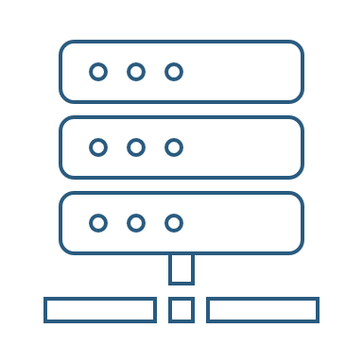

Risk | Mitigation
Broken computer | Risk prevention funds
Changing terms of use | Monitor
Servers down | Monitor
Incompatible timetables | Reschedule

Slide 105
Year 1: 2000 sales
Balance: -25168 €
Year 2: 4000 sales
Balance: 11441 €
44968 €
39600 €
28159 €
19800 €
Costs
Earnings
Costs
Earnings

Slide 106
Year 3: 8000 sales
Balance: 36450 €
79200 €
29023 €
Costs
Earnings

Slide 107

Monthly advertising costs
220 €
140 €
150 €

